Slide 1
Performance 101
Shekhar Berry
Manager, Performance and Scale Team
Jaison Raju
Associate Manager,
Performance and Scale Team

Slide 2

Introduction
Introduction
Name: Shekhar Berry
https://www.linkedin.com/in/shekhar-berry
Based out of Bangalore, India.
~9 Years at RH
Manager Perf and Scale, focused on storage and Virtualization

Slide 3

Introduction
Introduction
Name: Jaison Raju
Linkedin:
Based out of Bangalore, India.
~12 Years at RH
Associate Manager Perf and Scale, focused on OpenStack Performance and Scale engineering and OpenShift Chaos engineering

Slide 4
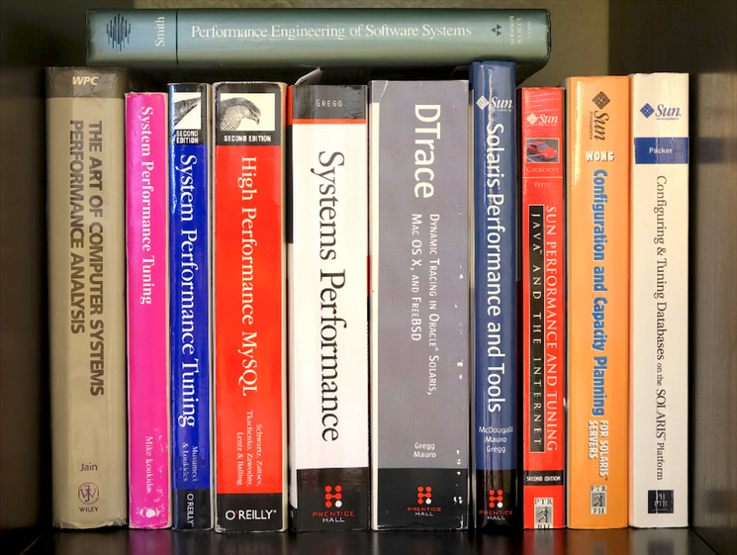
Performance in a Session!!
Introduction

Slide 5
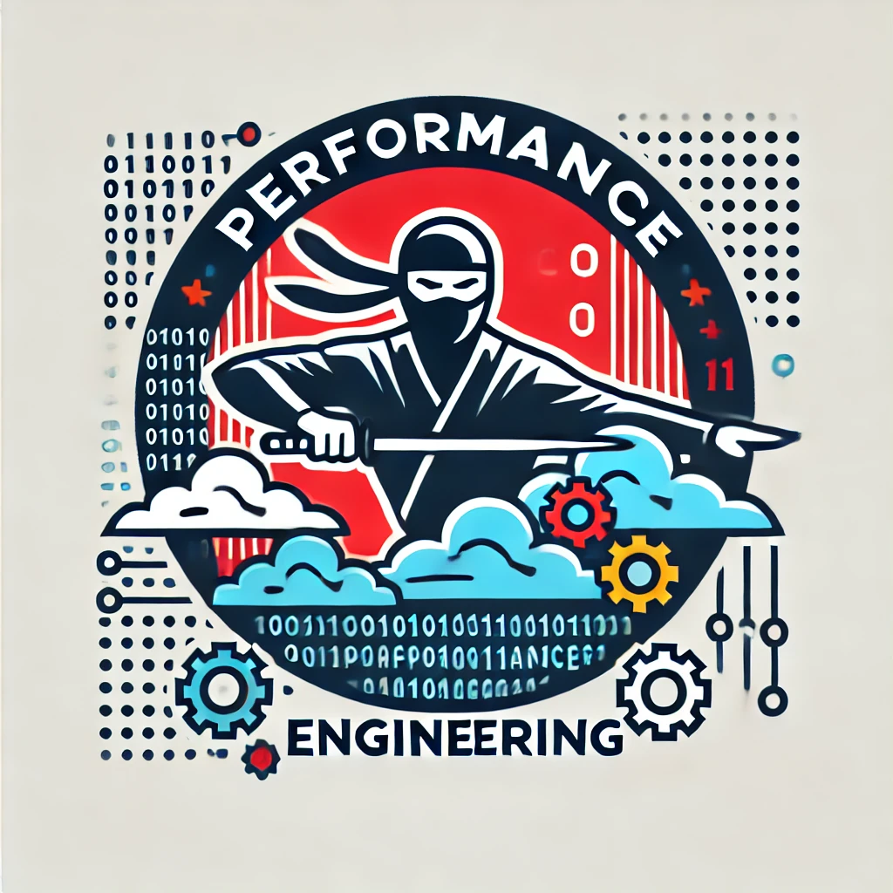
Performance Engineering Perspective
Performance
Performance is usually not at top of what people are interested in when they are building software.
What Software properties are more important than performance?
Why we are interested in performance then?

Slide 6

What is Performance Testing?
Performance
Performance testing is a type of software testing that focuses on evaluating how a system performs under different conditions, such as varying loads, stress levels, and concurrency.
The primary goal of performance testing is to ensure that the software meets specified performance criteria, such as response time, throughput, and resource utilization, under expected and peak usage scenarios.

Slide 7




Why Performance Test?
Performance
Speed - Does the application respond quickly enough for the intended users?
Scalability – Will the application handle the expected user load and beyond? (AKA
Capacity)
Stability – Is the application stable under expected and unexpected user loads? (AKA Robustness)
Resilient – Are you sure that users will have a positive experience on go-live day?

Slide 8
Performance Terminology
Performance
Throughput: Capability of a product to handle multiple transactions in a given period.Throughput represents the number of requests/business transactions processed by the product in a specified time duration.
Response Time: Response time is defined as the delay between the point of request and the first response from the product. The response time increases proportionally to the user load.
Tuning: Tuning is the procedure by which product performance is enhanced by setting different values to the parameters of the product, operating system and other components.
Benchmarking: Benchmarking is a process of measuring the performance of a company’s products, services, or processes against a known standard or set of standards. The goal of benchmarking is to evaluate the performance characteristics of the system and identify areas for improvement or optimization.

Slide 9
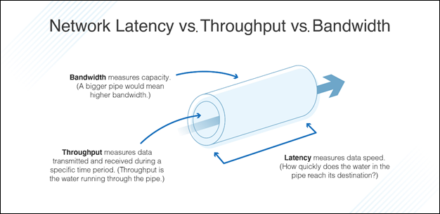
Network Latency vs. Throughput vs. Bandwidth
Performance

Slide 10
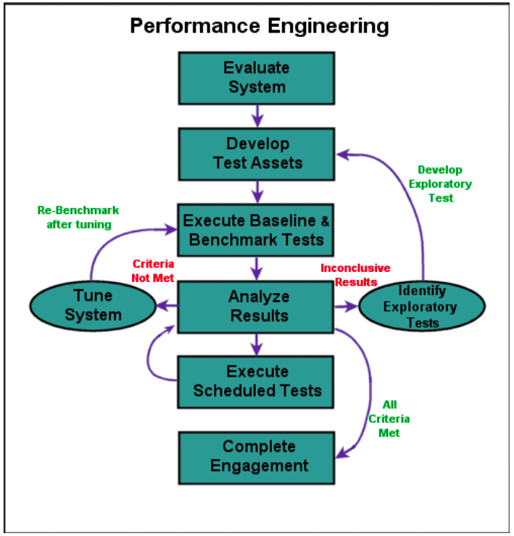
How we do Performance Testing
Performance

Slide 11
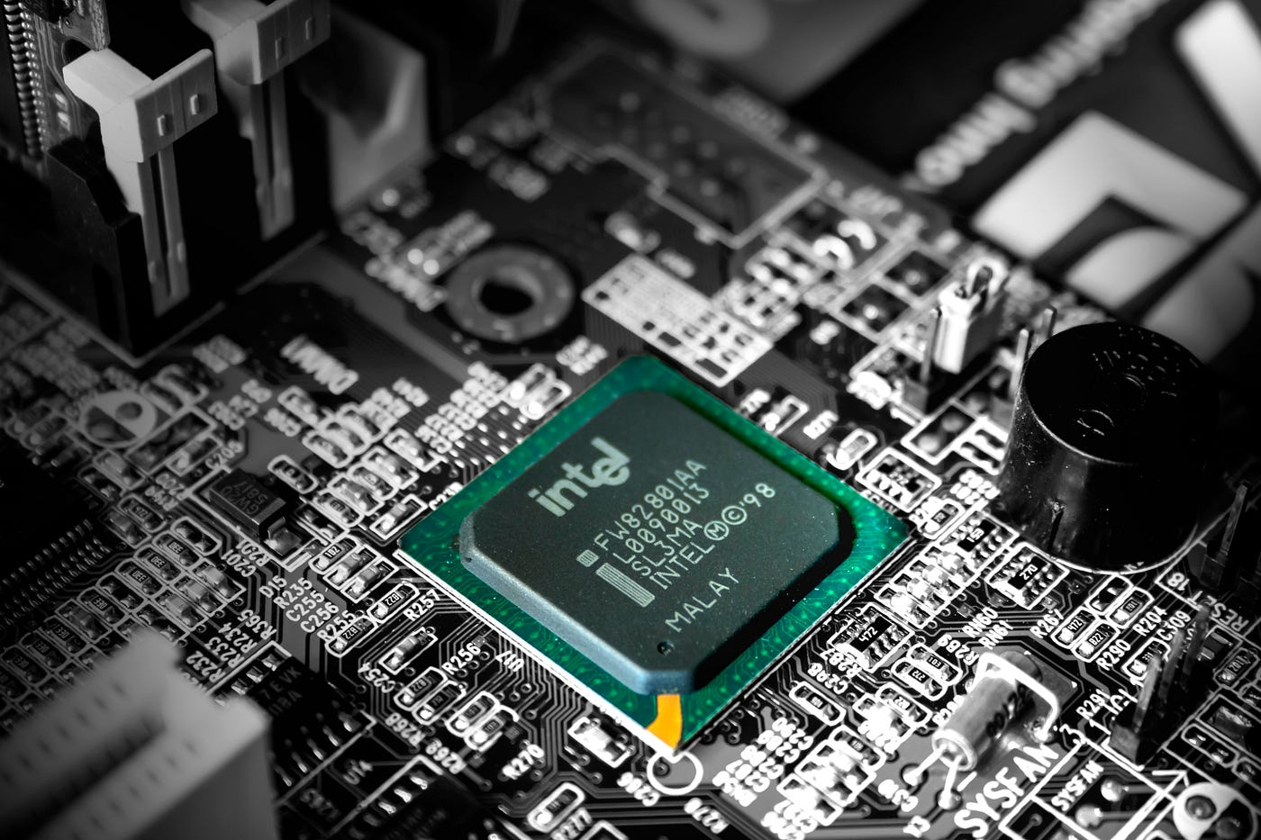

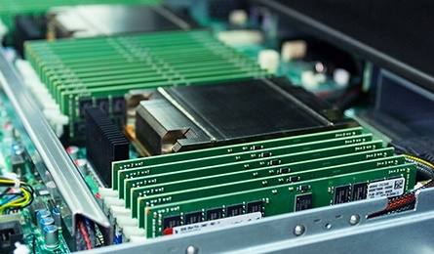
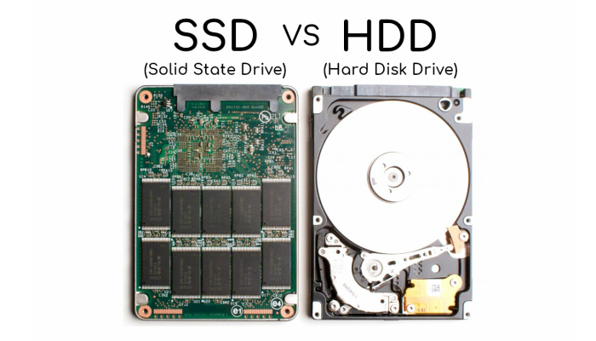
Performance Factors - hardware
Performance
Memory
Disks
CPU
Network

Slide 12
Performance Factors - System
Performance
Process / Thread deadlock
Process / Thread spinlocks , [fm]utex
Buffers / caches / limits
…..

Slide 13
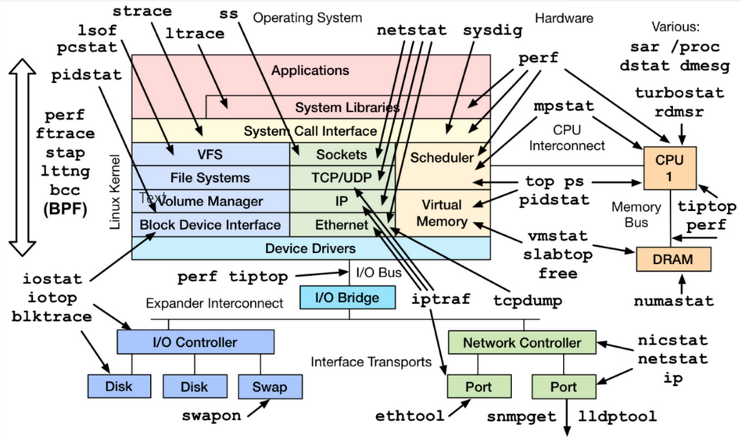
Data Collection: What to Collect?
Performance

Slide 14
Performance Factors - Application platform
Performance
??
???
…..

Slide 15
Application / Programming Platform Profilers
Performance

Slide 16
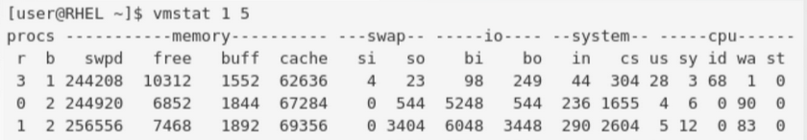
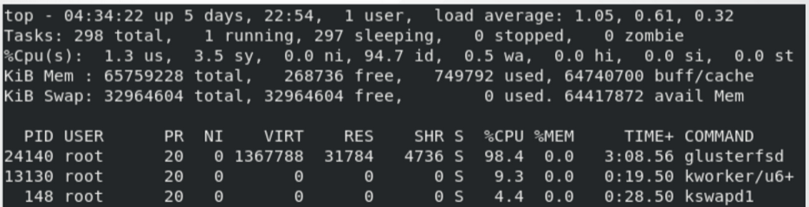
Data Analysis
Performance
Inbuilt Tools like VMSTAT, IOSTAT, SAR, TOP can give us a peek inside what is the bottleneck and what should be tuned to achieve better results

Slide 17
Data Analysis Summary
Performance
vmstat: look for swap activity (which is bad for performance), very high system CPU utilization (us+sy).
top: check the thread level CPU utilization output to see if any application or event threads is close to 100% CPU utilization.
iostat: disk busy (%util) close to 100 can sometimes indicate that the system is bottlenecked on disk I/O. This is not always true though, particularly with RAID devices and NVMe drives.
sar: network throughput data (rxkB/s, txkB/s) can show whether the network links are close to saturation.

Slide 18
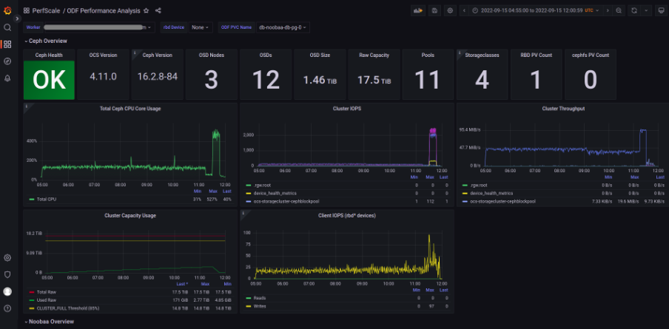
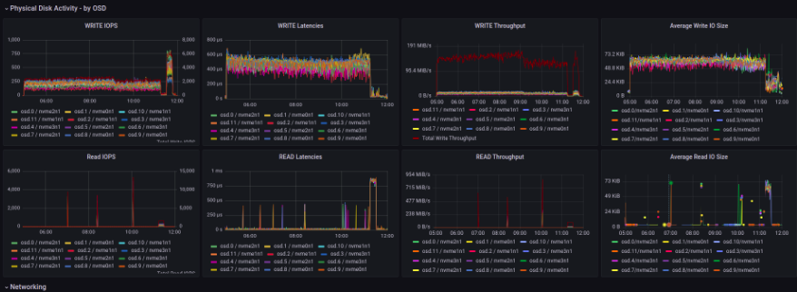
Data Analysis Using Grafana
Performance
https://github.com/redhat-performance/odf-grafana

Slide 19
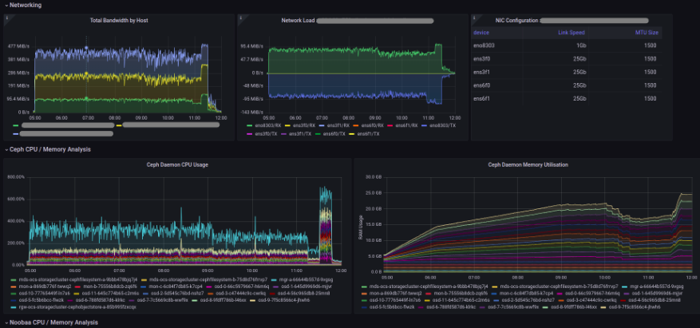
Data Analysis Using Grafana
Performance
https://github.com/redhat-performance/odf-grafana

Slide 20
Thank you
Red Hat is the world’s leading provider of enterprise open source software solutions. Award-winning support, training, and consulting services make
Red Hat a trusted adviser to the Fortune 500.

